Slide 1
MMBJ E-Commerce presentation
Presenter: John, Megha, Brian and Mahmood

Slide 2
Points to Discuss
Web Site Development
Web Hosting Services
Payment Systems
Merchant Accounts

Slide 3
WEB SITE DEVELOPMENT

Slide 4
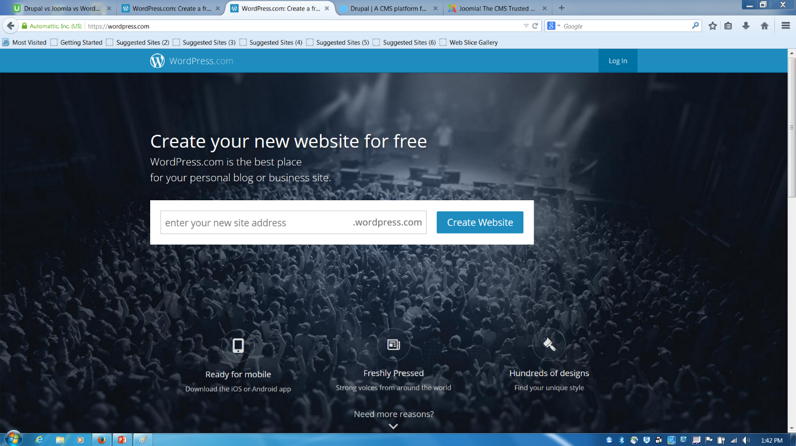
WordPress.com

Slide 5
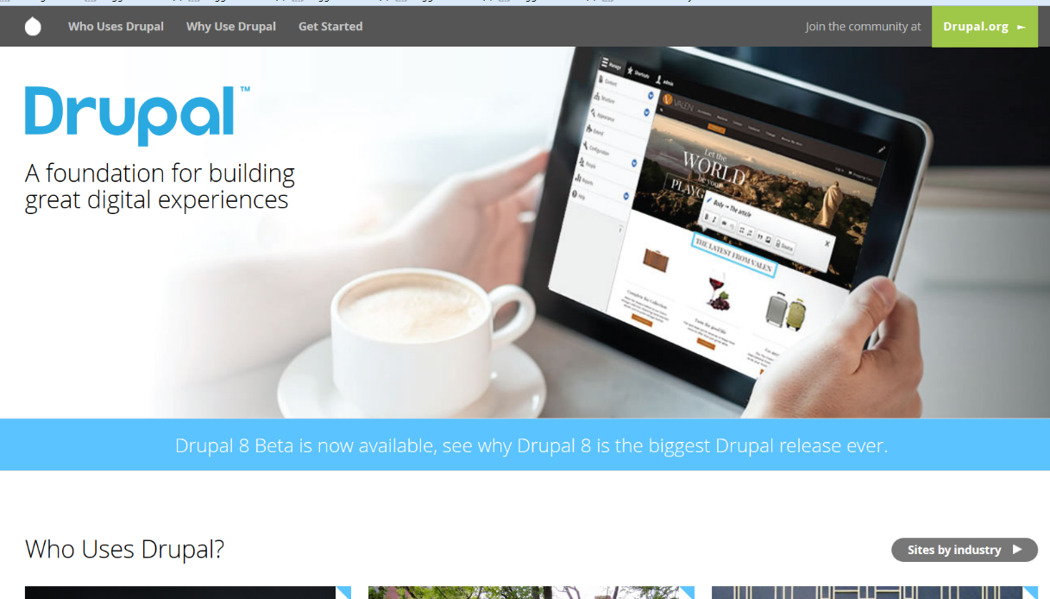
Drupal

Slide 6
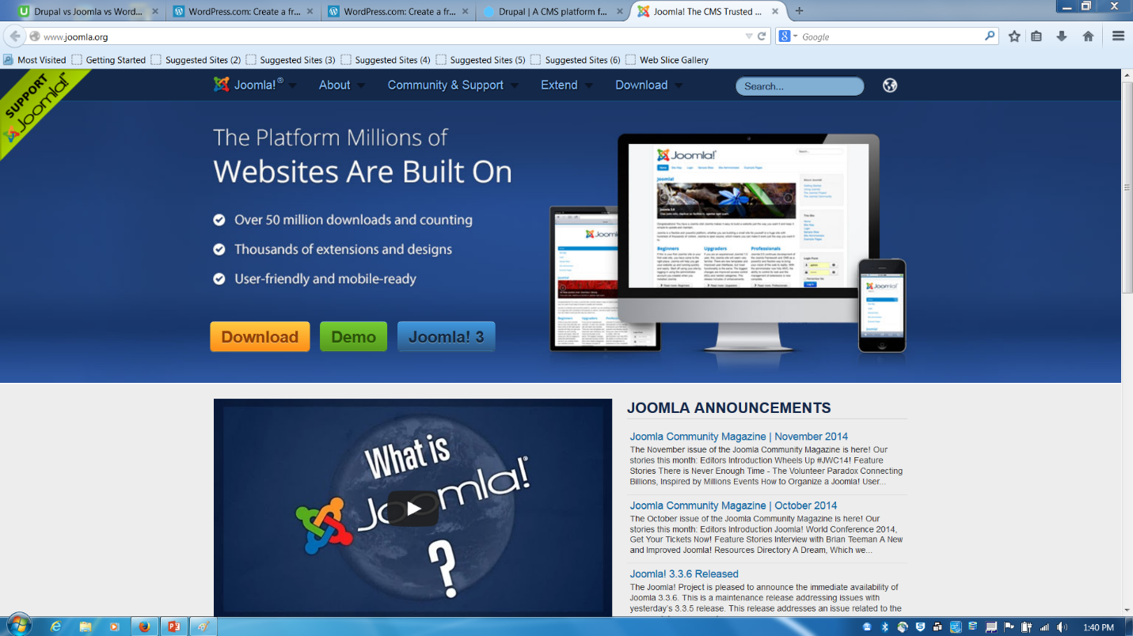
Joomla

Slide 7
Website development
Criteria/ Providers | Price (40%) | Developing time (30%) | Implementation difficulty (20%) | Level of complexity (10%) | Weightage average
Self built | 2 | 2 | 2 | 10 | 2.8
Wordpress | 9 | 8 | 9 | 4 | 8.2
Drupal | 7 | 8 | 4 | 3 | 6.3
Joomla | 9 | 8 | 7 | 3 | 7.7

Slide 8
WEB HOSTING SERVICES

Slide 9
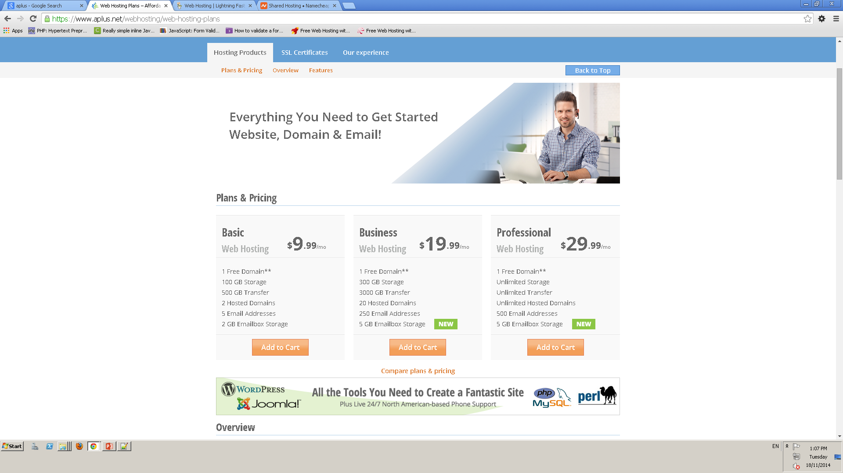
www.aplus.net

Slide 10
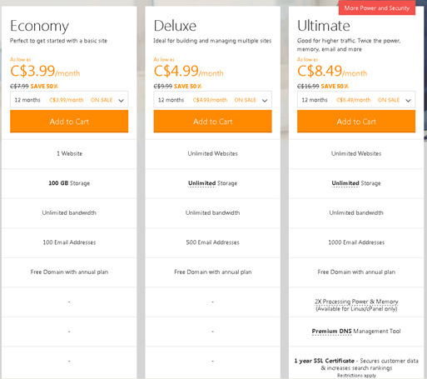
www.godaddy.com

Slide 11
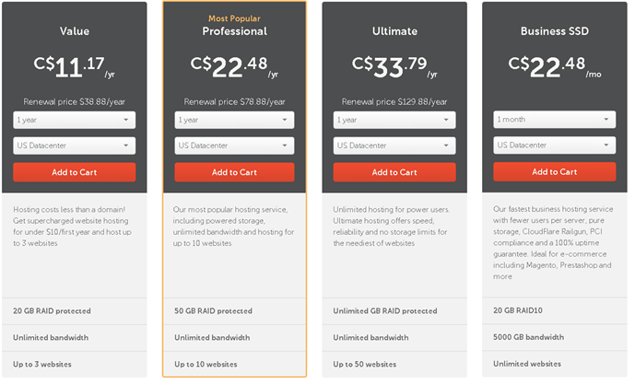
www.namecheap.com

Slide 12
Web Hosting
Providers/ Criteria | Price | Domain | Storage | Data Transfer | Email addresses | Bandwidth | Websites
aplus | $ 29.99 /month | 1 free | Unlimited + 5 GB email box storage | Unlimited | 500 | None | None
godaddy | $ 8.49 /month | 1 free with annual plan | Unlimited | Unlimited | 1000 | Unlimited | Unlimited
namecheap | $ 22.48 /year | 1 free | 50 GB RAID protected | Unlimited | N /A | Unlimited | Up to 10

Slide 13
PAYMENT SERVICES

Slide 14
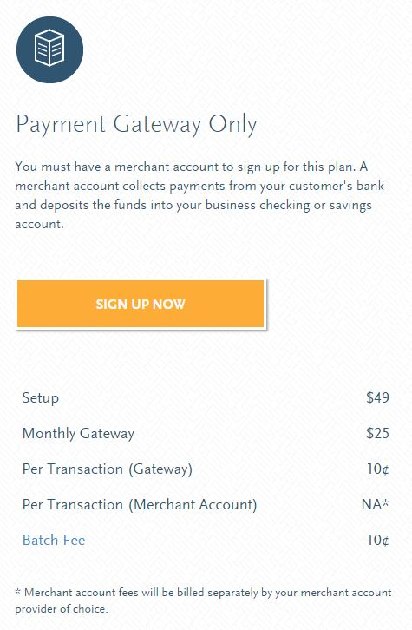
www.authorize.net

Slide 15
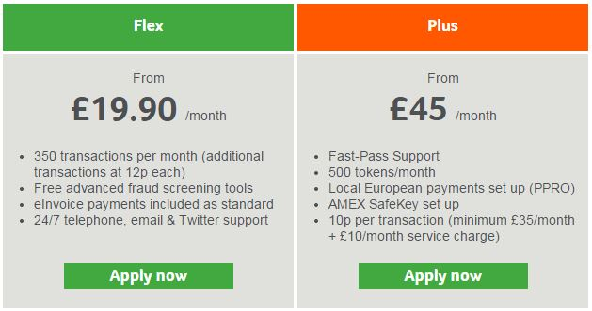
Sage Pay

Slide 16
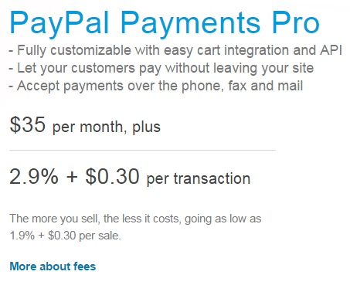

Slide 17
Payment Services
Criteria/ Providers | Cost (30%) | Integration (20%) | Security (25%) | Ease of Use (15%) | Customer Support (10%) | Score
Authorize.net | 7 | 8 | 10 | 9 | 9 | 8.5
Dwolla | 10 | 4 | 8 | 4 | 7 | 7.1
Sage pay | 5 | 10 | 9 | 9 | 8 | 7.9
Paypal Payments Pro | 1 | 6 | 10 | 8 | 7 | 5.9

Slide 18
MERCHANT ACCOUNTS

Slide 19


Slide 20


Slide 21
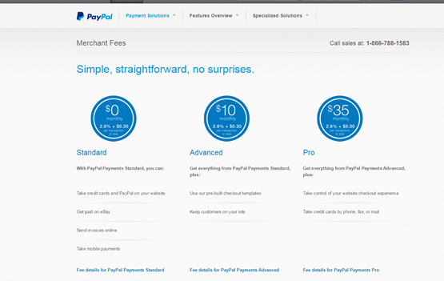

Slide 22
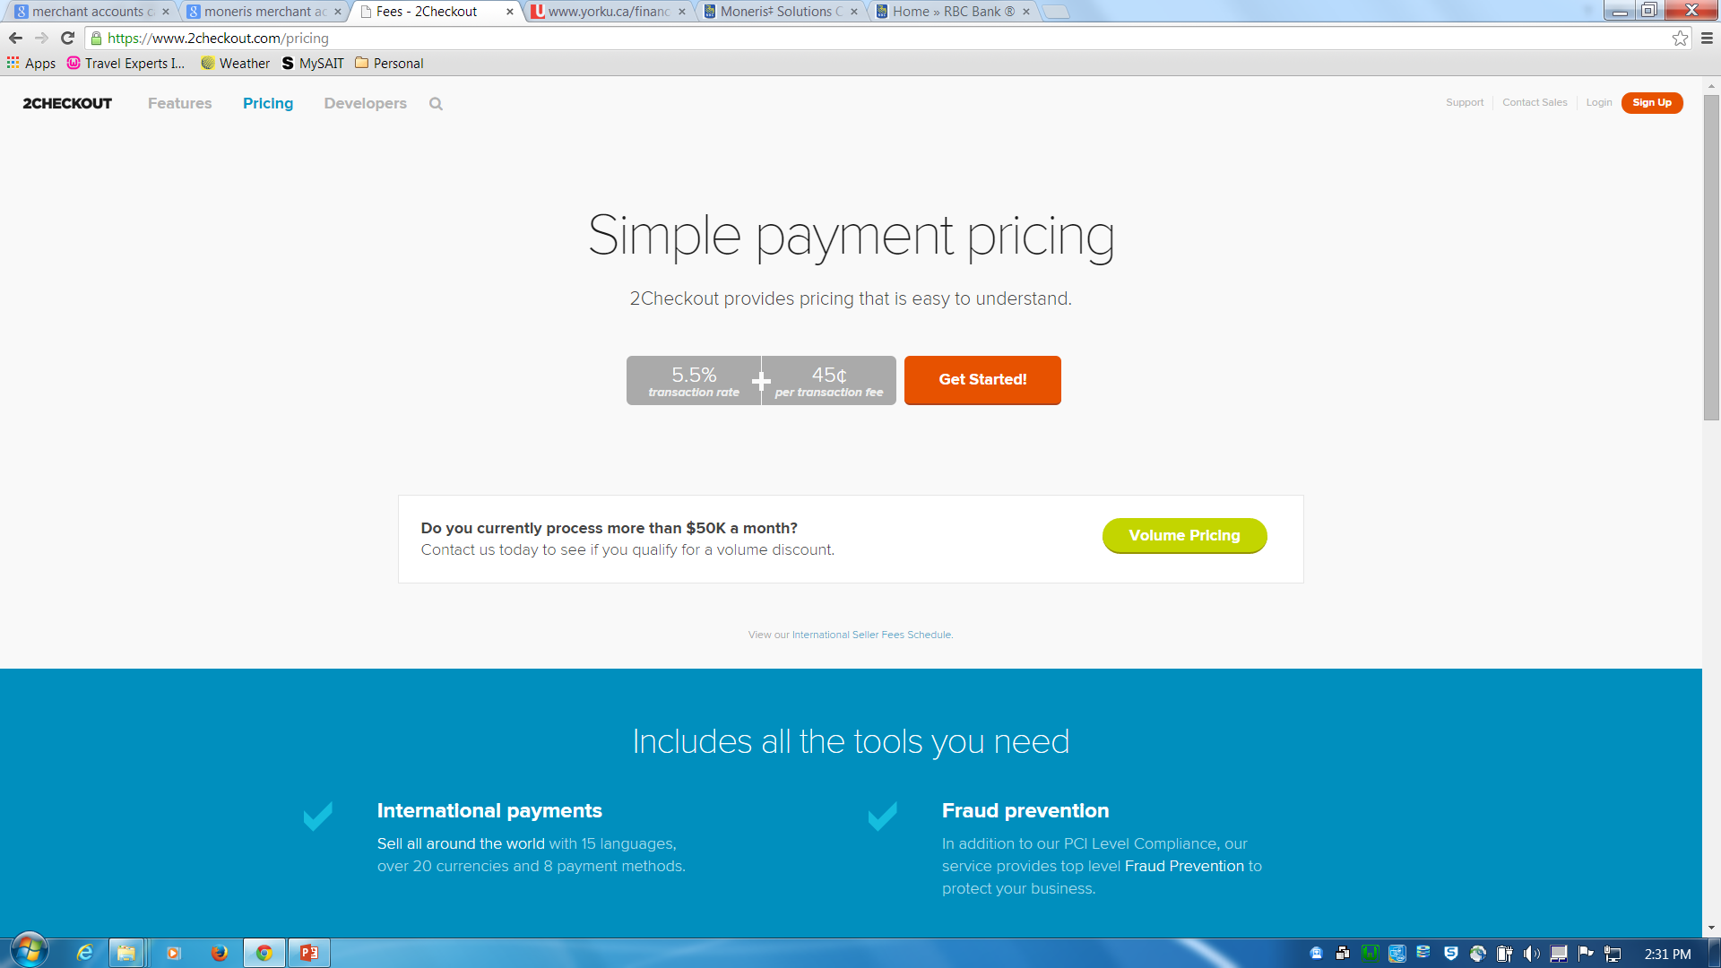
www.2checkout.com

Slide 23
Merchant Account
Criteria/ Providers | Setup fee | Monthly fee | Per transaction
TD | $ 199 | $ 35 | 10 c
Merchantaccounts.ca | $ 99 | $ 39 | 20 c
Paypal | None | $ 10 | 2.9% + 30 c
2checkout | None | None | 5.5% + 45 c

Slide 24
THANK YOU

